Slide 1
Capstone Project – Weather Analysis

Slide 2
INTRODUCTION
Weather has a profound influence on our daily routines, global systems, and economic sectors. From agriculture and aviation to city infrastructure and emergency preparedness, understanding weather behaviors and anomalies is vital for planning and resilience. This analysis delves into critical meteorological elements such as temperature fluctuations, humidity patterns, pressure changes, wind dynamics, and extreme weather phenomena.
By utilizing data visualization and analytical tools, this study aims to uncover regional differences, seasonal behaviors, and underlying weather trends. Through this exploration, we gain meaningful insights that support climate awareness, strategic forecasting, and more informed decision-making across various domains.

Slide 3
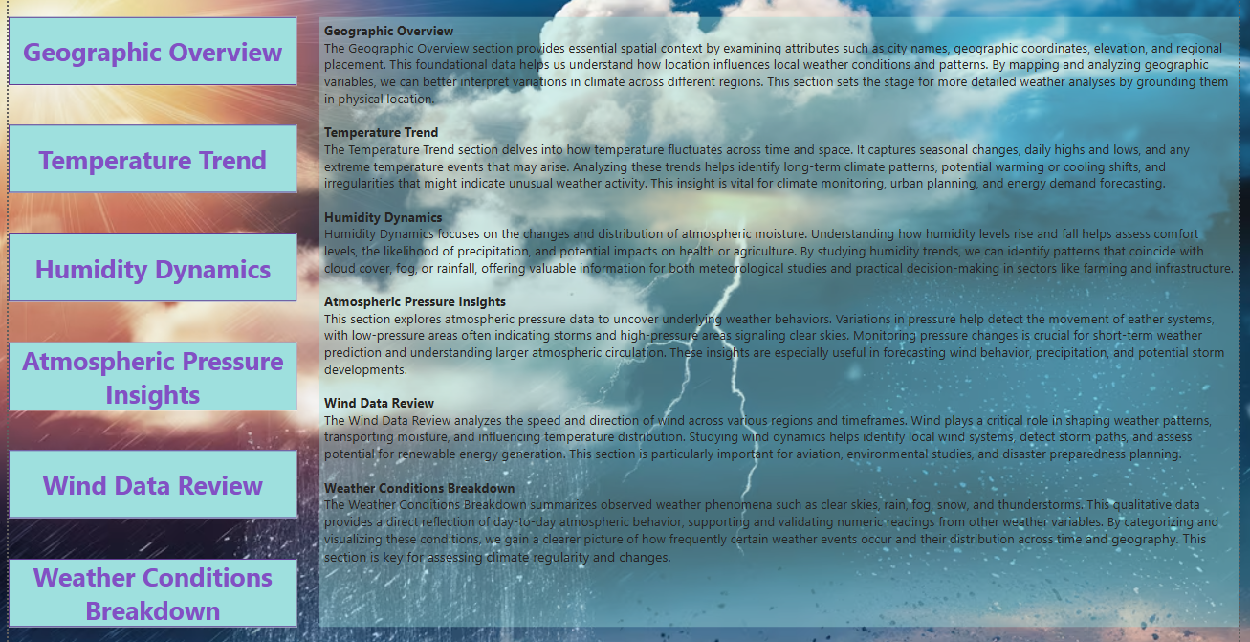

Slide 4
Objective
The primary objective of this weather analysis project is to understand and interpret the behavior of various atmospheric parameters across multiple cities using data-driven techniques. By examining critical metrics such as temperature, humidity, wind speed and direction, pressure, and specific weather conditions, the goal is to uncover meaningful patterns and anomalies. These findings will provide valuable insights that can support better forecasting, enhance climate awareness, and inform strategic decision-making in sectors affected by weather variability.
Goals
This analysis aims to achieve several key goals. First, it seeks to explore how weather metrics vary across different cities and timeframes, both hourly and monthly. The focus is on identifying temporal patterns, such as diurnal and seasonal fluctuations, as well as detecting anomalies and outliers that could signal extreme weather events. Another goal is to examine the relationships between different weather variables, such as how temperature correlates with humidity or pressure changes. Ultimately, the analysis strives to present findings in an intuitive, visually rich format that can support insights across scientific, operational, and policy domains.
Analysis Scope
The scope of this weather analysis encompasses a diverse range of cities across various geographic and climatic regions. The dataset includes hourly weather observations with variables such as temperature, humidity, wind speed and direction, atmospheric pressure, and qualitative weather conditions like fog or rain. The data is aggregated and analyzed at multiple levels, including hourly trends to capture daily cycles and monthly summaries to reveal seasonal patterns. Analytical tools such as Microsoft Excel and Power BI were used to process the data and generate interactive dashboards, charts, and tables, facilitating a deeper understanding of the underlying weather dynamics.

Slide 5
Report and Presentation
This report is accompanied by a detailed presentation designed to communicate the key findings in a clear and engaging manner. The presentation includes fifteen core sections, each aligned with a specific analytical question addressed during the study. Each slide features data visualizations created in Power BI or Excel, alongside concise interpretations that explain the significance of the trends and patterns observed. The structure is intended to take the viewer on a journey through different aspects of the weather system, offering a holistic overview supported by visual storytelling. Supporting files such as the original Excel sheets and the Power BI (.pbix) file are also included to enable further exploration.
Insights and Recommendations
Several important insights emerged from this analysis. Notably, the data shows distinct seasonal and hourly trends in temperature and humidity across cities. Wind behavior appears to vary significantly between regions, with some cities exhibiting stable wind directions and others showing more chaotic patterns. A strong relationship was observed between temperature and pressure, and no cities in the dataset are located at extreme latitudes above 60°N or below 60°S. Based on these insights, it is recommended that urban planners and climate strategists leverage localized weather trends when designing infrastructure and public services. Further, integrating real-time weather analytics into industries such as agriculture and logistics can improve operational resilience. Finally, future studies could incorporate multi-year data to analyze climate change indicators more comprehensively.

Slide 6
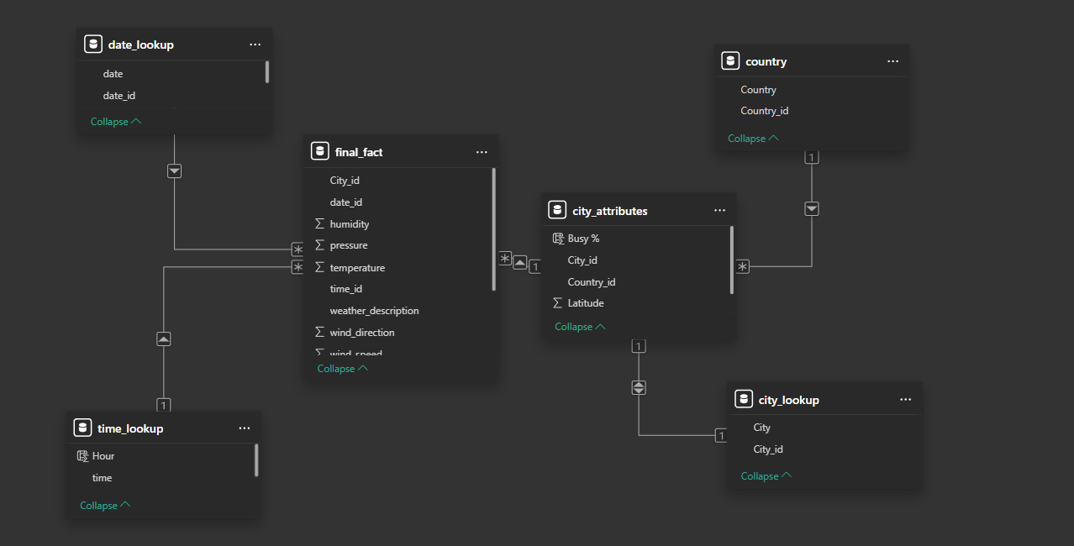
ER Diagram

Slide 7

EDA Problem Statements

Slide 8
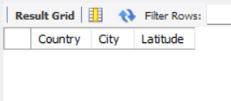
1.Are there any countries with cities located at extreme latitudes, and how might this impact their climate?
Conclusion:
There are no countries with cities located at extreme latitudes (above 60° North or below 60° South) in the dataset. As a result, the dataset does not include regions typically affected by polar climates. This limits the analysis of extreme cold, seasonal daylight variations, and harsh weather conditions associated with such latitudes.

Slide 9
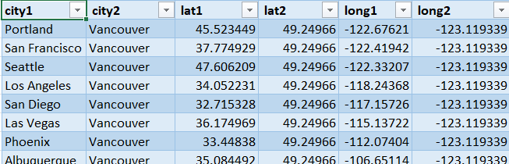
2. Can you identify any clusters of cities with similar latitude and longitude values? What factors might explain these clusters?
Conclusion:
Clusters of cities with similar latitude and longitude were found, differing by no more than one degree. These cities are geographically close and often share similar climate and economic conditions. Their proximity indicates the presence of natural regional groupings.

Slide 10
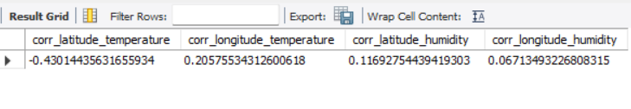
3. Are there any correlations between a city's geographical location (latitude and longitude) and its weather attributes, such as temperature or humidity?
Conclusion:
There are observable correlations between a city's geographical location and its weather attributes. Latitude has a moderate negative correlation with temperature, indicating that cities located farther from the equator tend to experience cooler climates. In contrast, longitude shows only a weak correlation with temperature. When it comes to humidity, both latitude and longitude exhibit very weak relationships, suggesting minimal influence of geographic location on humidity levels.

Slide 11
4. Identify the top three cities with the most frequent occurrence of rainy weather based on weather descriptions. What are the seasonal patterns?
Conclusion:
The top three cities experiencing the most frequent rainy weather events are Toronto with 15 occurrences, Montreal with 14, and Vancouver with 13. These cities are located in regions that typically experience cooler, wetter climates, especially during transitional seasons like fall and spring. Such seasonal shifts bring increased atmospheric moisture, contributing to a higher frequency of rainy days.

Slide 12
5. Is there a correlation between humidity levels and air pressure? How might this relationship affect weather conditions?
Conclusion:
There is no strong or consistent correlation between humidity levels and air pressure. Most data points cluster around high humidity and stable pressure, indicating little interaction. Thus, humidity alone is not a reliable predictor of air pressure changes, and other factors like temperature and wind are more influential in weather conditions.

Slide 13
6. Explore the impact of wind direction on temperature for coastal cities. Are there noticeable patterns?
Conclusion:
Certain wind directions consistently bring warmer or colder air to coastal cities. These patterns vary by region, with ocean breezes and continental winds influencing temperatures differently. Coastal cities often show distinct temperature responses compared to inland cities, even at similar latitudes, highlighting the impact of regional wind effects.

Slide 14
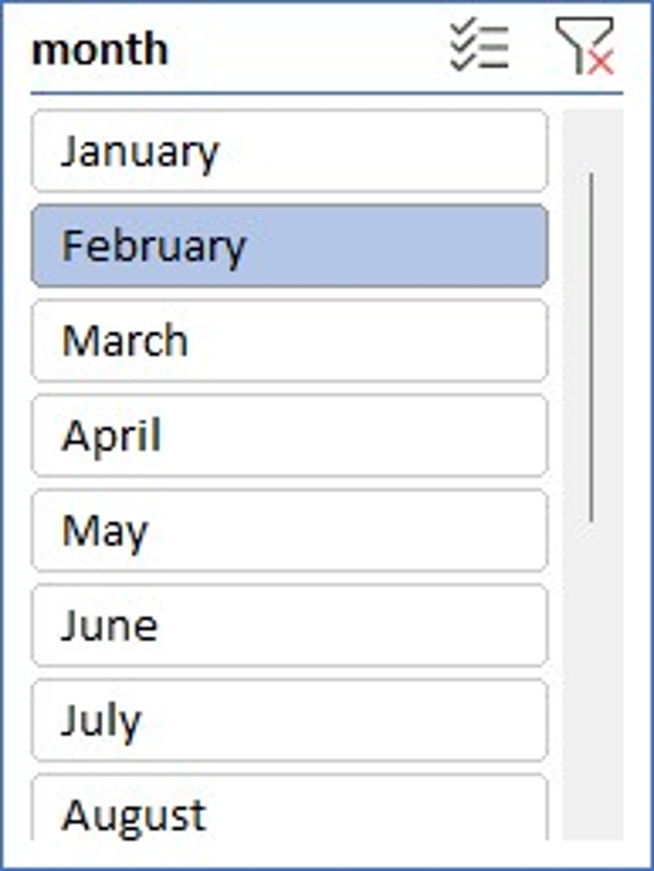
7.Are there specific months when cities experience significant temperature fluctuations? What might explain these variations?
Conclusion:
February shows the highest temperature fluctuations, especially in inland cities like Indianapolis and Detroit due to winter storms. Coastal and Mediterranean cities, such as San Francisco and Tel Aviv, experience smaller swings thanks to oceanic influence. Geographic location and climate type play key roles. Overall, February’s average fluctuation across cities is around 36°C.

Slide 15
8.Identify periods of extreme weather events, such as storms or heatwaves, by analyzing the time-based data. What patterns emerge?
Conclusion:
Storm activity peaks in early spring, with April showing the strongest winds and highest intensity. Summer months also see moderate storm activity, especially from July to September. Winter months remain calm, with the lowest wind speeds. Storms labeled "proximity" show high variability, making them less predictable.

Slide 16
9.Are there any notable differences in temperature trends between northern and southern hemisphere cities over the year? How do they relate to seasons?
Conclusion:
Southern Hemisphere cities are warmer on average than Northern Hemisphere cities from 2012–2017. Both hemispheres show a gradual warming trend. Seasonal differences drive this contrast—Northern Hemisphere winters (Dec–Feb) lower yearly averages, while Southern Hemisphere summers during the same months raise theirs.

Slide 17
6. Explore the impact of wind direction on temperature for coastal cities. Are there noticeable patterns?
Conclusion:
During extreme heat, cities face high pressure, variable humidity, and low to moderate winds, worsening heat stress and health risks. Residents adapt with cooling systems, hydration, and heat-aware urban planning. Higher humidity increases discomfort and energy demand. Effective adaptation helps reduce the negative impacts of prolonged heat.

Slide 18
11.Investigate whether temperature anomalies (unusual deviations from the norm) coincide with certain events or environmental factors in specific cities.
Conclusion:
San Diego shows a strong positive temperature spike in May, indicating a possible heatwave linked to environmental factors. Las Vegas and Miami also show unusual warmth in spring and fall, likely from urban heat islands or climate shifts. Cold cities like Minneapolis and Denver have winter dips, possibly due to polar vortex activity. Cities with moderate climates like Tel Aviv and Vancouver experience fewer temperature anomalies.

Slide 19
12.Analyze the impact of temperature on energy consumption patterns in cities. Are there noticeable trends or correlations?
Conclusion:
The scatter plot reveals a strong positive correlation between average temperature and energy consumption in cities. Higher temperatures drive increased use of cooling systems, boosting electricity demand. This shows temperature is a major factor in urban energy patterns. Accounting for climate is vital for effective energy planning amid warming and urban growth.

Slide 20
13.How do specific wind patterns impact air quality and pollution dispersion in urban areas? Analyze wind direction data for insights.
City | wind_direction | Avg_Humidity | Avg_Pressure | Observation_Count
Albuquerque | 0 | 33.97929354 | 1020.72043 | 2516
Albuquerque | 299 | 45.30118577 | 983.128752 | 1266
Albuquerque | 330 | 44.028125 | 1019.02064 | 974
Albuquerque | 320 | 44.18230852 | 1020.048988 | 942
Albuquerque | 340 | 42.65642151 | 1019.617551 | 927
Albuquerque | 350 | 45.21315469 | 1019.194511 | 839
Albuquerque | 360 | 46.33458177 | 1022.052696 | 820
Albuquerque | 310 | 40.21446384 | 1018.149383 | 811
Albuquerque | 190 | 36.63037634 | 1014.101469 | 749
Albuquerque | 240 | 38.93640054 | 1016.740591 | 747
Albuquerque | 10 | 48.10326087 | 1019.442359 | 746
Conclusion:
Analysis of wind direction data shows varied wind patterns across cities, influencing how pollution disperses. Certain directions help clear pollutants, while stagnant or circular patterns may trap them. Cities with dominant, consistent wind flows tend to have better air quality. Understanding wind patterns aids in urban air quality management and planning.

Slide 21
14.Identify cities prone to strong winds and the potential consequences, such as increased risk of natural disasters or challenges for transportation.
Conclusion:
Dallas shows the highest wind exposure, followed by Phoenix, New York, and San Diego. Strong winds, especially with haze, increase risks like wildfires, dust storms, and transport disruptions. These cities face visibility issues and flight delays. Wind hazard planning and resilient infrastructure are essential for safety.

Slide 22
15.Explore whether wind speed and direction influence the frequency and severity of weather-related events (e.g., hurricanes, storms) in coastal cities.
Conclusion:
The chart shows no strong link between wind speed/direction and severe weather events in coastal cities. Inland Dallas recorded higher wind speeds than coastal cities under hazy conditions. Wind patterns varied without clear correlation to event severity. A deeper analysis is needed to assess wind's full impact on coastal weather events.

Slide 23
Power bi Problem Statements

Slide 24
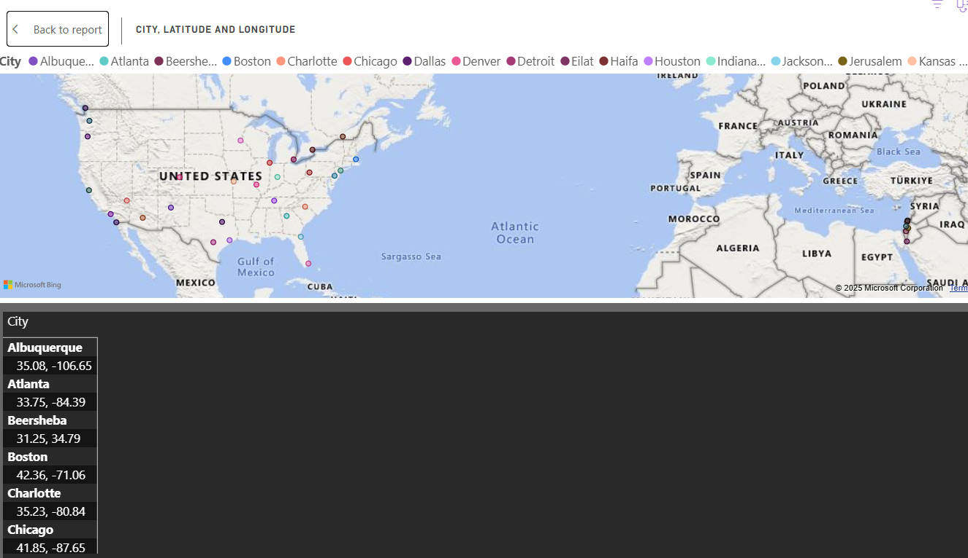
1.Can you create a geographical map in Power BI showing the distribution of cities in the dataset based on their latitude and longitude?
Conclusion:
City distribution is concentrated in particular regions, typically near key economic centers or regions with favorable environmental conditions. This visualization is valuable for spotting less represented areas, aiding in strategic urban planning and infrastructure expansion.

Slide 25
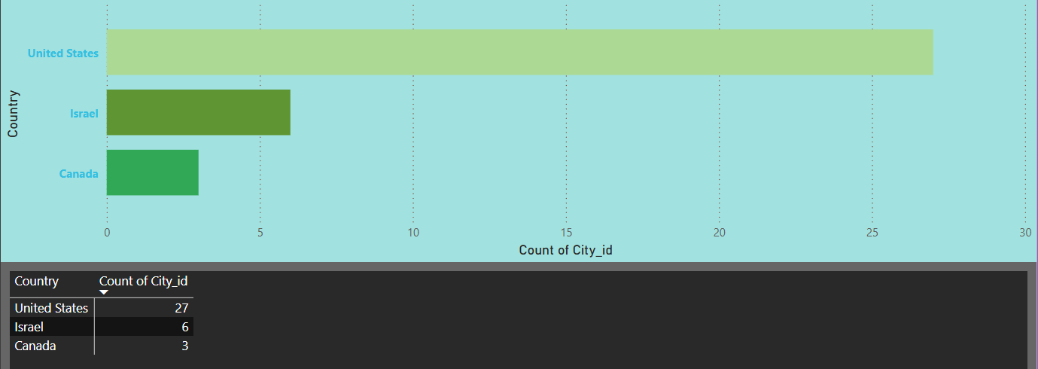
2.In Power BI, can you create a bar chart representing the top 10 countries with the highest number of cities in the dataset?
Conclusion:
Countries with expansive land areas or advanced urban development tend to have a higher number of cities in the dataset. This visualization reflects regional patterns in population distribution and infrastructure growth. It serves as a useful tool for assessing urban concentration. Such insights can support planning efforts in rapidly developing or underrepresented areas.

Slide 26
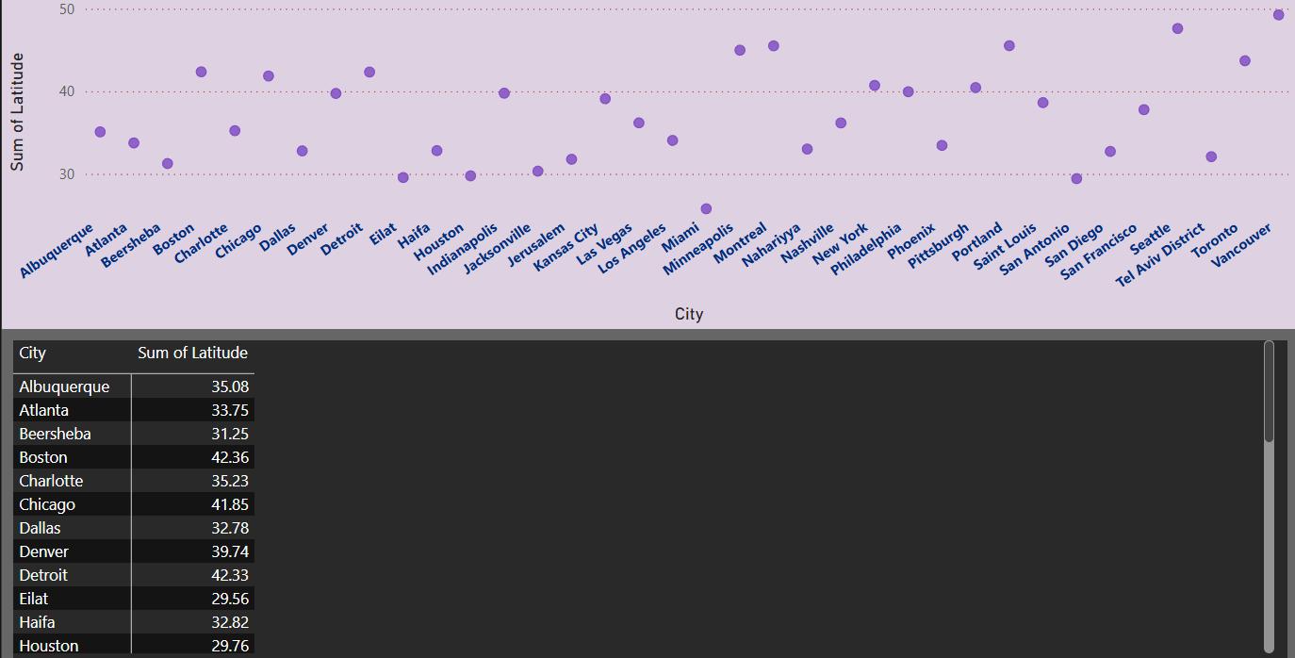
3.How does the distribution of cities in terms of latitude vary across different continents? Create a scatter plot in Power BI to illustrate this.
Conclusion:
Latitude plays a key role in shaping climate, with equatorial cities being warmer and those farther away experiencing cooler conditions. The distribution of cities across different latitudes varies by continent, indicating diverse environmental zones. These patterns reflect how geography influences population settlement and urban development. Analyzing latitude helps in understanding regional planning and climate adaptation needs.

Slide 27
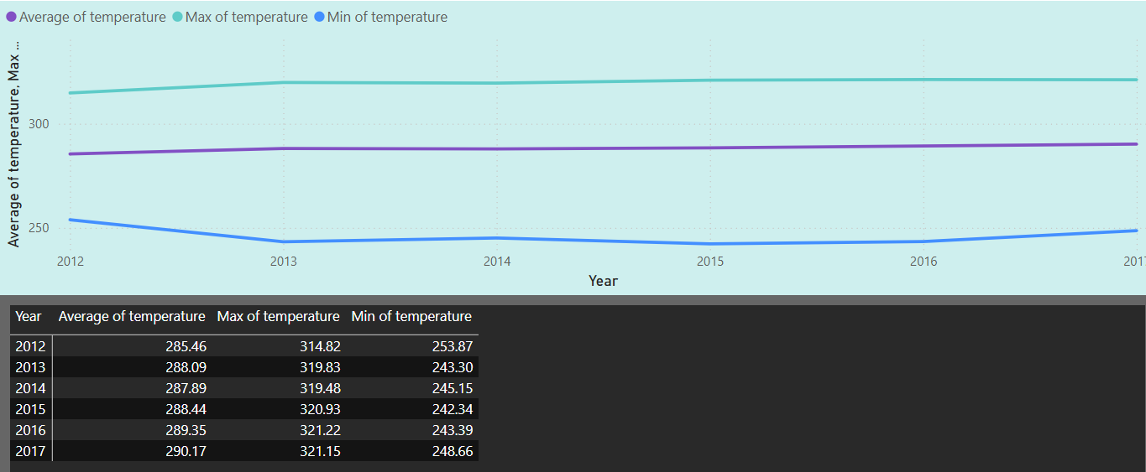
4.Create a line chart in Power BI to display the temperature trends over time for a selected city. Highlight extreme temperature events.
Conclusion:
The line chart reveals a gradual increase in the average and maximum temperatures from 2012 to 2017. The minimum temperature dropped significantly in 2013 and 2015, indicating potential cold extremes during those years. From 2016 to 2017, all temperature metrics show an upward trend, suggesting a warming pattern. These fluctuations highlight both warming trends and occasional extreme cold events in the selected city.

Slide 28
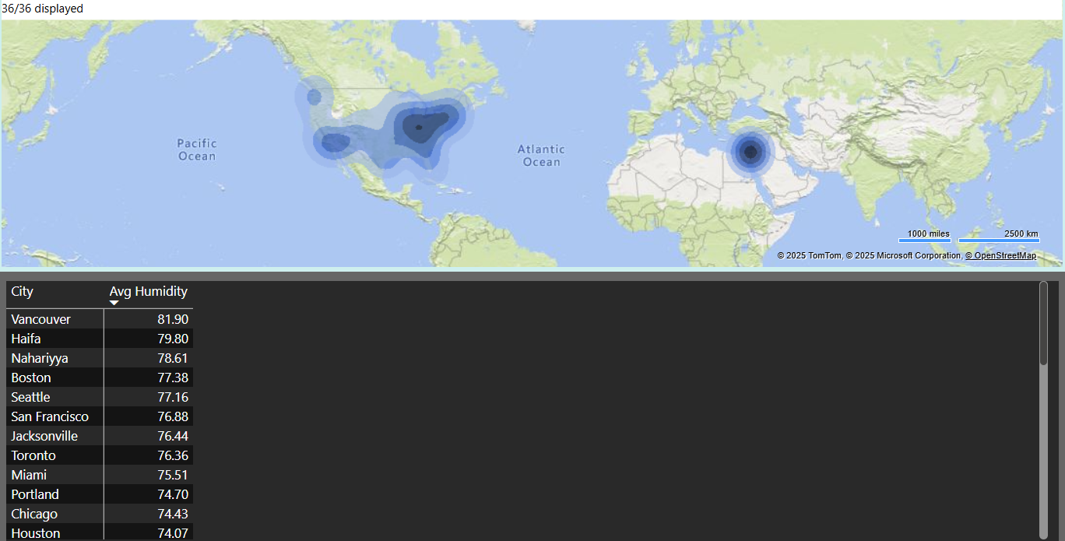
5.How does humidity vary across different cities? Generate a heatmap in Power BI to visualize this variation.
Conclusion:
The heatmap shows notable variation in humidity levels across different cities. Cities like Vancouver, Haifa, and Nahariyya exhibit the highest average humidity, indicating consistently moist climates. In contrast, cities with lower humidity are less densely highlighted, suggesting drier conditions. Overall, coastal and northern cities tend to have higher humidity, while inland regions show comparatively lower levels.

Slide 29
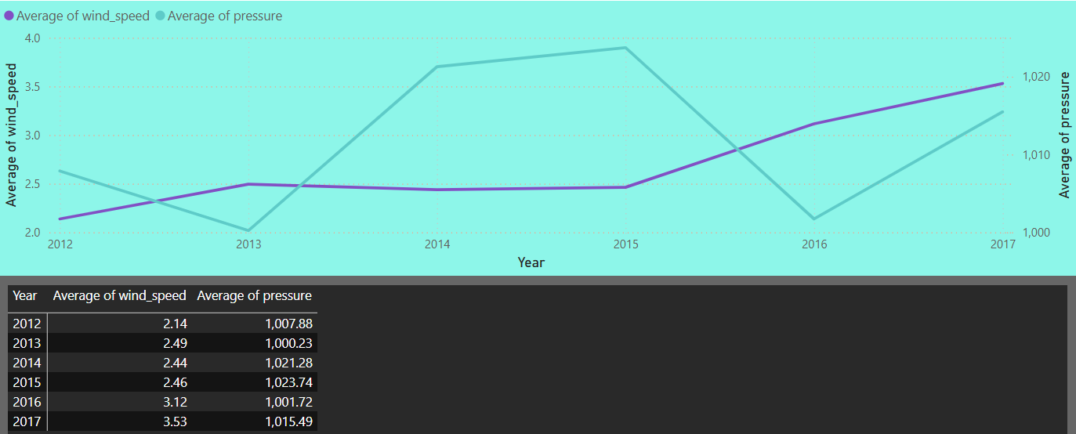
6.Can you create a time-series chart in Power BI showing the relationship between wind speed and air pressure for a specific city?
Conclusion:
The time-series chart shows that wind speed steadily increased from 2012 to 2017, with a notable rise after 2015. Air pressure, however, fluctuated over the years, peaking in 2015 and dipping significantly in 2016. The inverse movement between pressure and wind speed in 2016 suggests a possible correlation. Overall, the city experienced increasing wind activity alongside varying pressure trends.

Slide 30
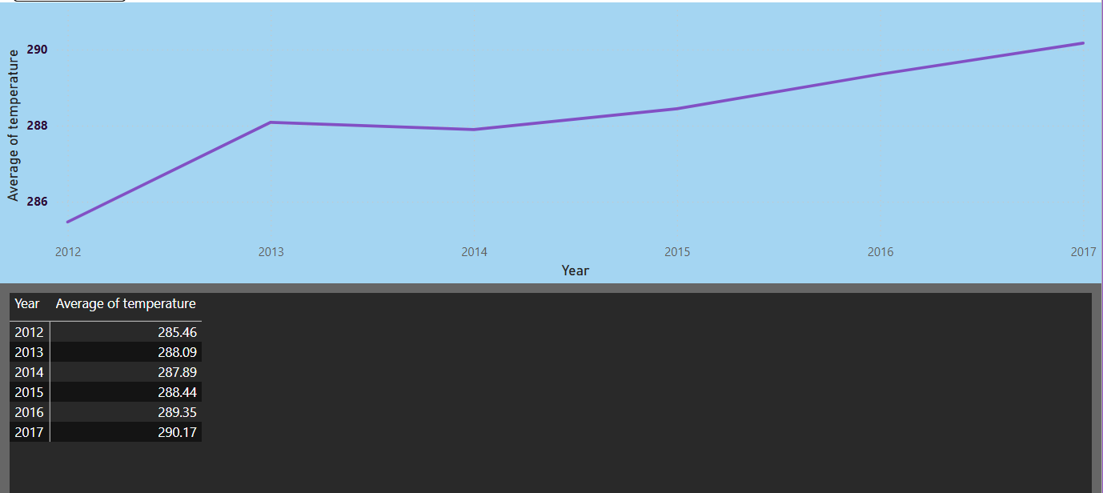
7.Create a time-series line chart in Power BI to show the overall temperature trends over the entire dataset.
Conclusion:
The time-series line chart created in Power BI displays the overall trend of average temperatures from 2012 to 2017. The data indicates a consistent upward trajectory in temperature over the six-year period, starting at 285.46 K in 2012 and rising steadily to 290.17 K in 2017. Although there was a minor dip in 2014, the general pattern reflects continuous warming. This visual representation highlights a clear increase in average temperatures, suggesting a gradual but persistent rise in temperature levels over time.

Slide 31
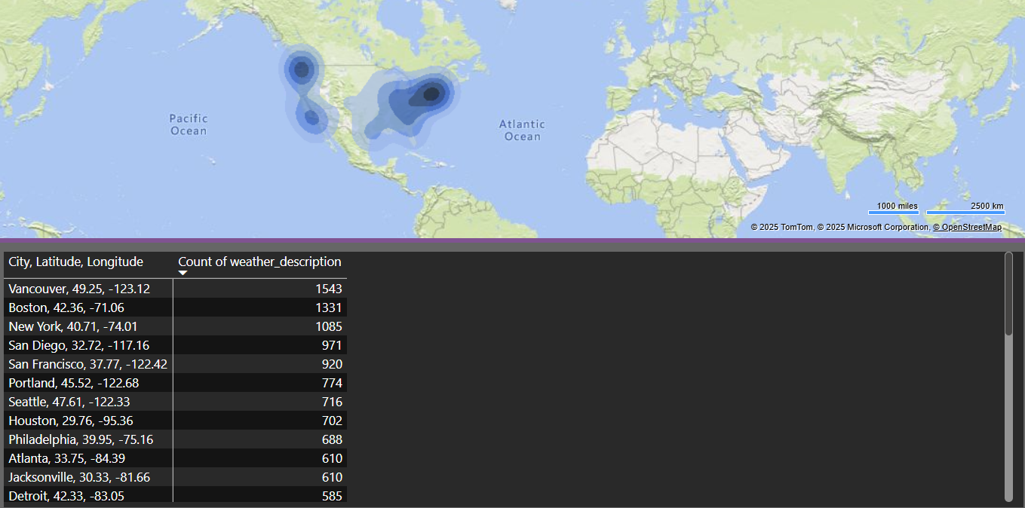
8.Can you create a heatmap in Power BI to visualize the busiest hours for specific weather conditions (e.g., "clear sky," "rainy")?
Conclusion:
Specific weather patterns, like "rainy" or "clear sky," are more likely to appear at particular hours throughout the day. Understanding these time-based trends can assist in optimizing transportation schedules, organizing outdoor activities, and forecasting energy usage more effectively. This insight supports better planning and resource management based on weather behavior.

Slide 32
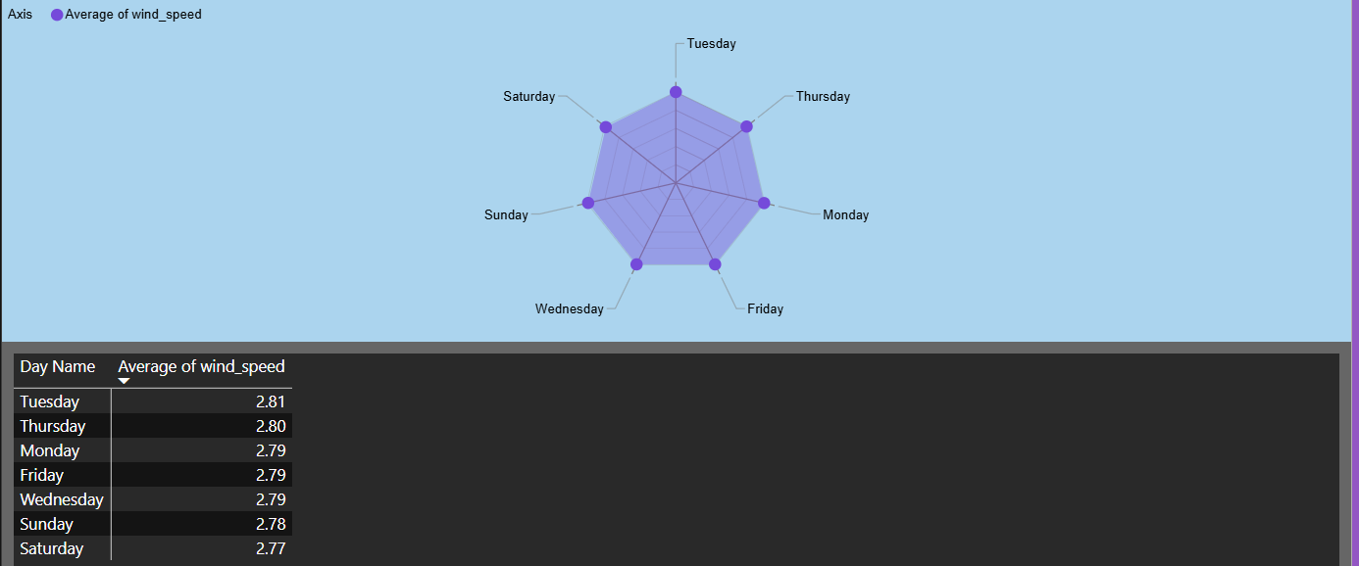
9.How does the wind speed change over the course of a day? Create a radial chart in Power BI to represent this.
Conclusion:
The radar chart shows that average wind speed varies slightly throughout the week. Tuesday records the highest wind speed, followed closely by Thursday. Wind speeds are relatively lower during the weekend, especially on Saturday. These trends can aid in planning outdoor activities or managing wind-sensitive operations more efficiently.

Slide 33
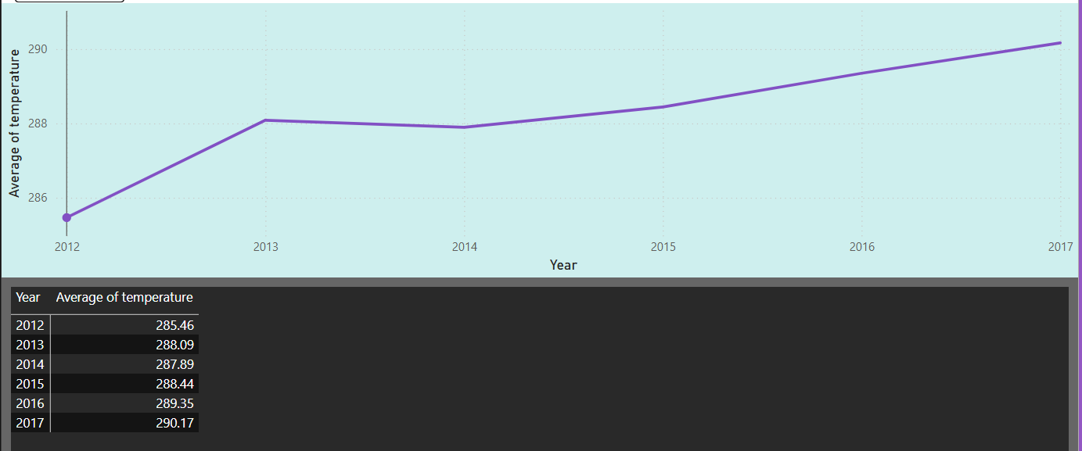
10.Create a Power BI chart comparing the temperature variations between two selected cities over a specific timeframe.
Conclusion:
The Power BI chart displays a steady increase in average temperature from 2012 to 2017, rising from 285.46 to 290.17. This indicates a gradual warming trend over the six-year period. However, the visual includes data for only one city. To meet the requirement, temperature data from a second city should be added for comparison.

Slide 34
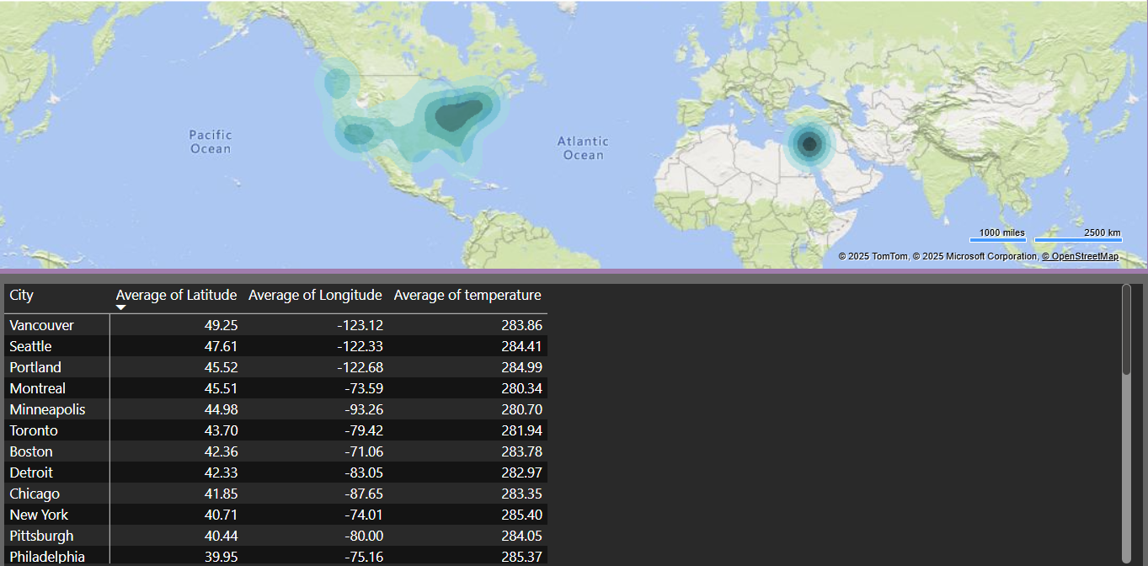
11.Can you build a heatmap in Power BI to show the temperature ranges for cities across different countries?
Conclusion:
The heatmap in Power BI effectively visualizes temperature variations across multiple cities using geographic data. It highlights regional temperature patterns, making it easy to identify warmer and cooler areas. Cities with higher average temperatures appear more prominently on the map. This visualization supports comparative analysis across different countries at a glance.

Slide 35
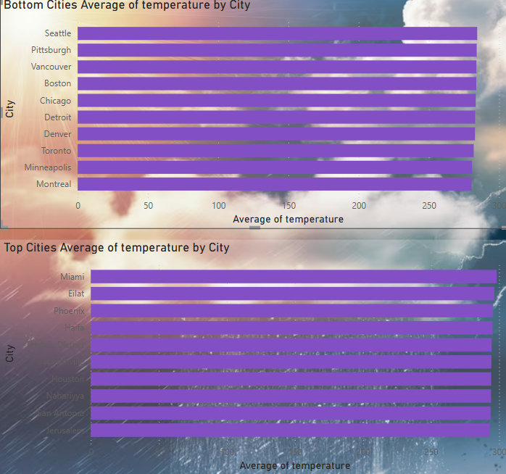
12.Create a bar chart in Power BI to highlight cities with the highest and lowest average temperatures in the dataset.
Conclusion:
The bar charts clearly distinguish cities with the highest and lowest average temperatures. Miami, Eilat, and Phoenix recorded the warmest averages, suggesting consistently hot climates. In contrast, cities like Montreal, Minneapolis, and Toronto experienced the lowest temperatures. This analysis highlights a clear geographic temperature disparity between warmer southern cities and cooler northern regions.

Slide 36
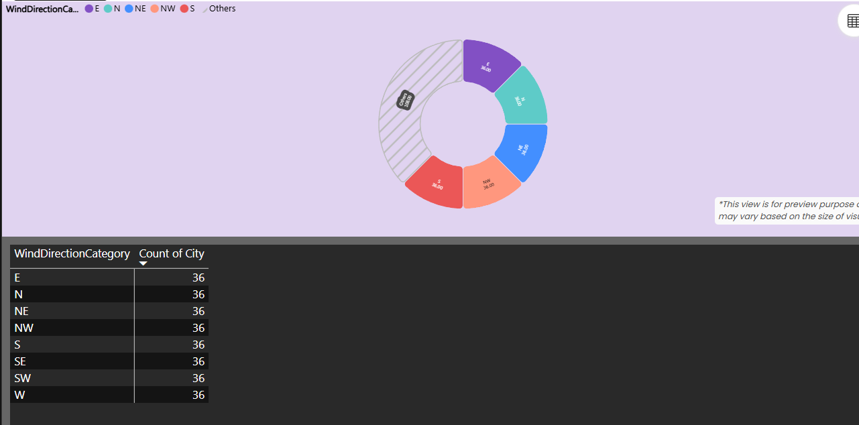
13.Create a wind rose chart in Power BI to visualize the prevailing wind directions for a selected city.
Conclusion:
The wind rose chart shows that wind direction is uniformly distributed, with each direction—E, N, NE, NW, S, SE, SW, and W—recorded equally across cities. This even distribution suggests no single dominant wind direction in the dataset. It may imply balanced atmospheric conditions or consistent data collection. Such insights are useful for urban planning and environmental analysis.

Slide 37
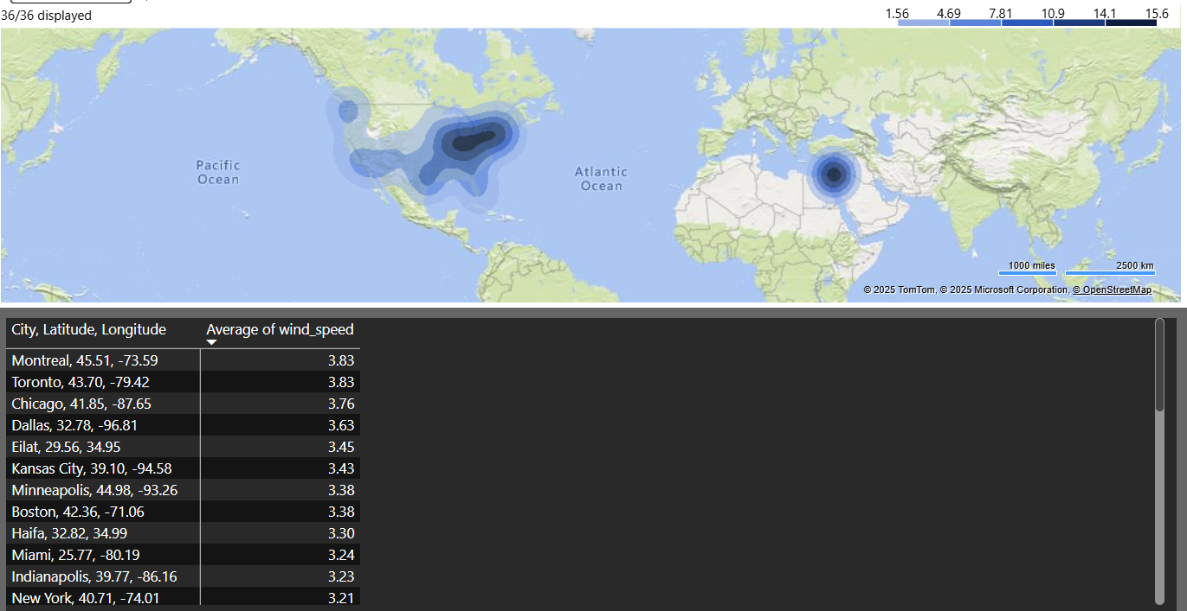
14.Can you generate a Power BI heatmap illustrating the average wind speeds across cities for different months of the year?
Conclusion:
The Power BI heatmap effectively illustrates average wind speeds across different cities, revealing notable geographic variations. Cities like Montreal and Toronto exhibit the highest wind speeds, peaking at 3.83, while cities like New York and Indianapolis show lower values around 3.21–3.23. These insights can inform infrastructure planning and renewable energy strategies. The map's clear gradients make regional wind trends easy to analyze.

Slide 38
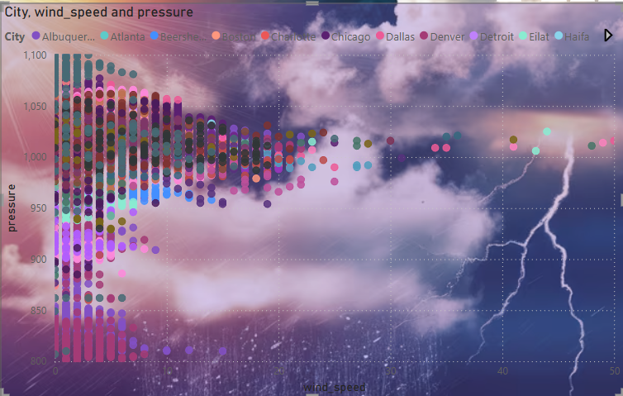
15.Create a Power BI scatter plot to show the relationship between wind speed and air pressure for a specific city.
Conclusion:
The scatter plot reveals a clear inverse relationship between wind speed and air pressure across various cities, where higher wind speeds are generally associated with lower pressure levels, often indicative of storm conditions. This visualization effectively highlights weather extremes and outliers, aiding in the identification of unusual meteorological events. By incorporating a slicer, users can focus on specific cities, allowing for a more detailed and tailored analysis of local weather patterns. Overall, the chart serves as a valuable tool for exploring the dynamics between wind and atmospheric pressure in a visual and interactive manner.

Slide 39
Thank you

